Slide 1
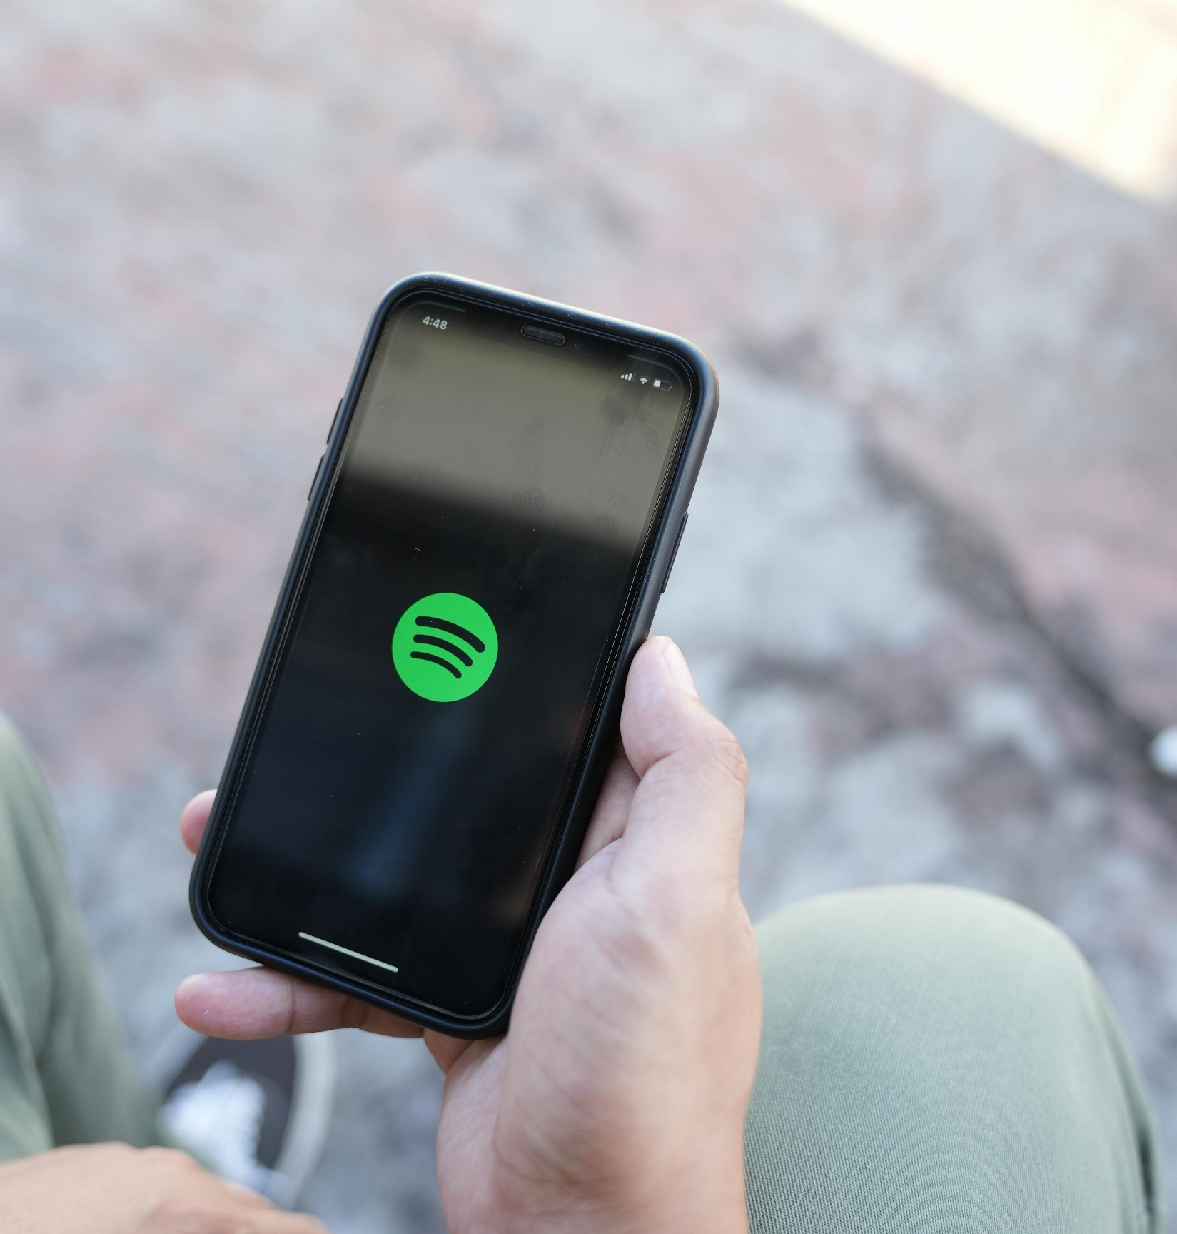
Semantic Title Generation for Song Lyrics with AI Models and Prompt Engineering
Notes:
Good morning everyone. My name is Pablo Egger Prieto, and today I’ll be presenting my research on semantic title generation for song lyrics using AI models and prompt engineering. This project explores how well AI can generate meaningful song titles from lyrics, the impact of prompt engineering on improving the results, and how effectively AI can express emotions compared to humans.

Slide 2
AGENDA
Problem Description
Dataset and Model
Methodology
Results and Evaluation
Conclusion
Future Work
Notes:
Here is a quick outline of what I will be covering today.

Slide 3

Problem description
Problem: Every song has a message, a meaning, a feeling, a story to be told. But how do we condense that story into just a few words?
Why is it important? Titles provide the first impression and transmit a certain motion, hence making a good title crucial for the listeners experience (and therefore marketing)
Challenges Songs are often abstract and include figures of speech (e.g. metaphors, similes, etc.) which are difficult to capture by AI
Balancing creativity and semantic relevance
Notes:
Every song has a message, a meaning, a feeling, a story to be told. But how do we condense that story into just a few words?
Why is it important? Well, titles are responsible for a listener’s first impression and therefore influences the listener’s overall experience, therefore also making it crucial to be able to name songs well. The challenge is that songs often use abstract language, metaphors, and other linguistic expressions—things AI struggles with. Unlike us humans, AI lacks intuition and context, making it harder to capture the real emotions transmitted by a song.

Slide 4
The goal
Predict song titles based on lyrics using AI and different prompts
Evaluate the performances of both in terms of semantic similarity
Compare and contrast the emotional resonance of the (predicted) title
Research question
What is the impact of prompt engineering on the semantic accuracy, emotional resonance, and strength of AI-generated song titles?
Notes:
The main goal of this project is to use AI models to predict song titles based on lyrics, and evaluate how well to do so, comparing different prompts.
Moreover, I wanted to look closer at how strong the predicted title is from an emotional perspective, and compare it to the actual title, chosen by a human, usually the artist itself.
Specifically, I want to be able to answer the following research question: What is the impact of prompt engineering on the semantic accuracy, emotional resonance, and strength of AI-generated song titles?

Slide 5
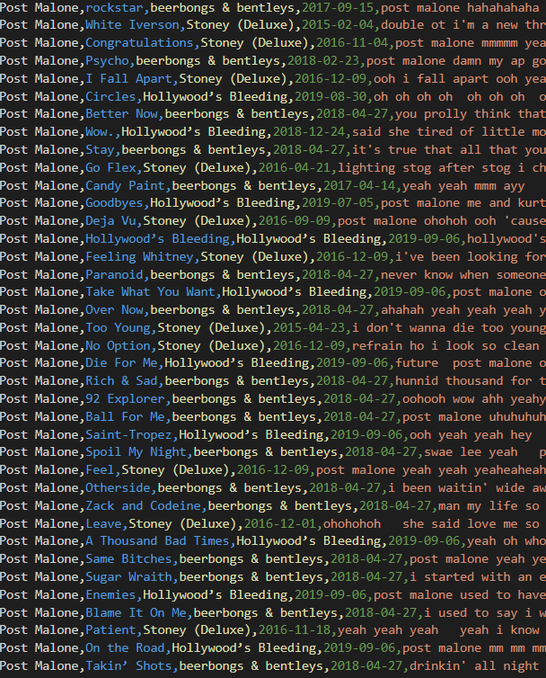
Dataset & Model
Data
21 artists
12,054 total songs
Artist, Title, Album, Date, Lyric, Year
Size: 22mb
Model: Pegasus-7b-slerp.Q4_K_S.gguf
Parameters: 7 billion
Transformer - based LM
Trained on web pages, books, articles, etc.
Size: 3.9GB
SLERP (Spherical Linear Interpolation)
Notes:
The Pegasus 7B model is a 7-billion-parameter Transformer-based language model, designed for tasks like text generation and summarization. It was trained on diverse datasets, including web pages, books, and articles meaning it has a strong understanding of the language in a range of different texts. Hence, I wanted to test it on song data.

Slide 6
Methodology
PEGASUS
OUTPUT:
Song Title
INPUT:
Lyrics
Notes:
At a high level, the methodology is quite straightforward: We use as input the lyrics, run it through the model, and get a song title as output.

Slide 7
Methodology
PROMPT 1
OUTPUT:
Song Title
INPUT:
Lyrics
PROMPT 2
PROMPT 3
PROMPT 4
 | Prompt | Idea
Prompt 1 | "Analyze the following song lyrics and generate a concise title using only words or phrases that appear directly in the lyrics: {lyrics}" | Very detailed and instructive query
Prompt 2 | "Find a title: {lyrics}" | Very vague
Prompt 3 | "What would you name the following songs based on its lyrics: {lyrics}" | Instructive query giving it some freedom
Prompt 4 | "Summarize the following lyrics in a few key words: {lyrics}" | Titles are often sort of summaries
Notes:
However, if we break it down further, I used 4 different prompts to run through the model.
Here are the four prompts I used. [read prompts and explain why these]

Slide 8
Methodology
PROMPT 1
OUTPUT 1
INPUT:
Lyrics
PROMPT 2
OUTPUT 2
PROMPT 3
OUTPUT 3
PROMPT 4
OUTPUT 4

Slide 9
Methodology
Predicted Title
Semantic Similarity Score
Actual Title
OUTPUT 1
OUTPUT 2
OUTPUT 3
OUTPUT 4
Notes:
As I already said, the ouput of the model is a song title. However, simply determining whether it is exactly the same as the true title would not be sufficient. Therfore, we can calculate the semantic similarity between the predicted title and the true title.

Slide 10

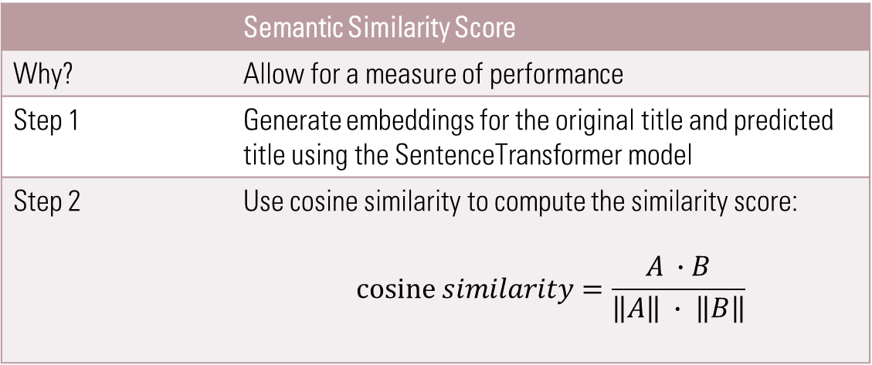
Methodology: Semantic Similarity SCore
 | Semantic Similarity Score
Why? | Allow for a measure of performance
Step 1 | Generate embeddings for the original title and predicted title using the SentenceTransformer model
Step 2 | Use cosine similarity to compute the similarity score: $$cosine similarity=\frac{A ∙B}{\left\|A\right\| ∙ \left\|B\right\|}$$
Entirely different words
Not too different in terms of meaning
Notes:
Why do we do this? Because simply comparing the predicted with the true title it wouldn’t tell us anything about how incorrect the incorrect predictions are. After creating embeddings of the titles, I used the SentenceTransformer model and calculated the cosine similarity like this.
Here is an example [show Rockstar vs Party Animal example]

Slide 11
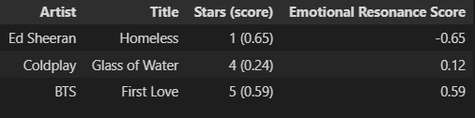
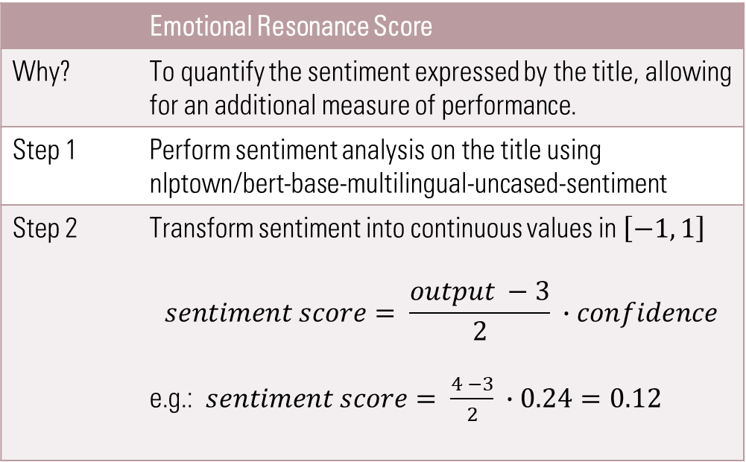
Methodology: Emotional Resonance
 | Emotional Resonance Score
Why? | To quantify the sentiment expressed by the title, allowing for an additional measure of performance.
Step 1 | Perform sentiment analysis on the title using nlptown/bert-base-multilingual-uncased-sentiment
Step 2 | Transform sentiment into continuous values in $\left[−1, 1\right]$ $$sentiment score= \frac{output −3}{2} ∙confidence$$ e.g.: $sentiment score= \frac{4 −3}{2} ∙0.24=0.12$
Notes:
Emotional Resonance is defined as the “the process where one person's emotions significantly impact another, leading to a shared emotional experience”. To measure this, I created my own unique and novel measure of emotional resonance.
I found a pre-trained model that can perform sentiment analysis to determine how positive or negative a sentence is. The issue with this model however is that it calculates this by returning both the strength of the sentiment as well as its confidence level. I noticed that this is not ideal for my case, as the titles are very short, meaning that even the slightest deviation in them may return a very different sentiment strength, while being less certain of this value (lower confidence)

Slide 12
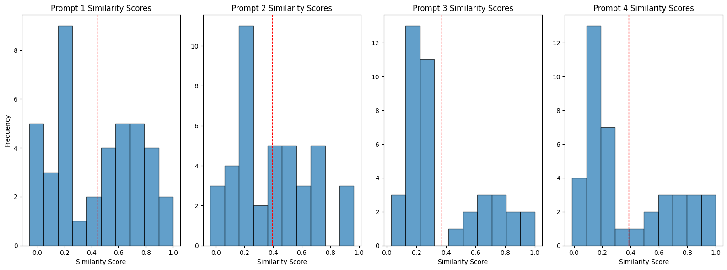
Results: Similarity SCore
Avg similarity:
0.48
0.39
0.37
0.38

Slide 13
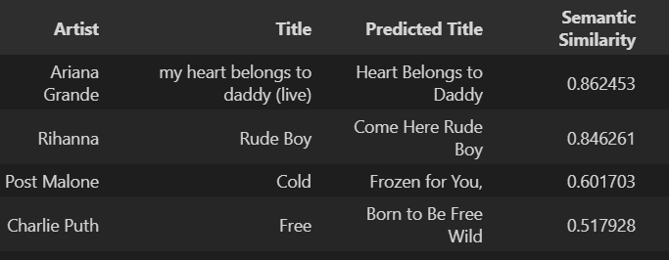

Results: examples
Notes:
Here I have a few examples to get a feeling of what the scores mean

Slide 14
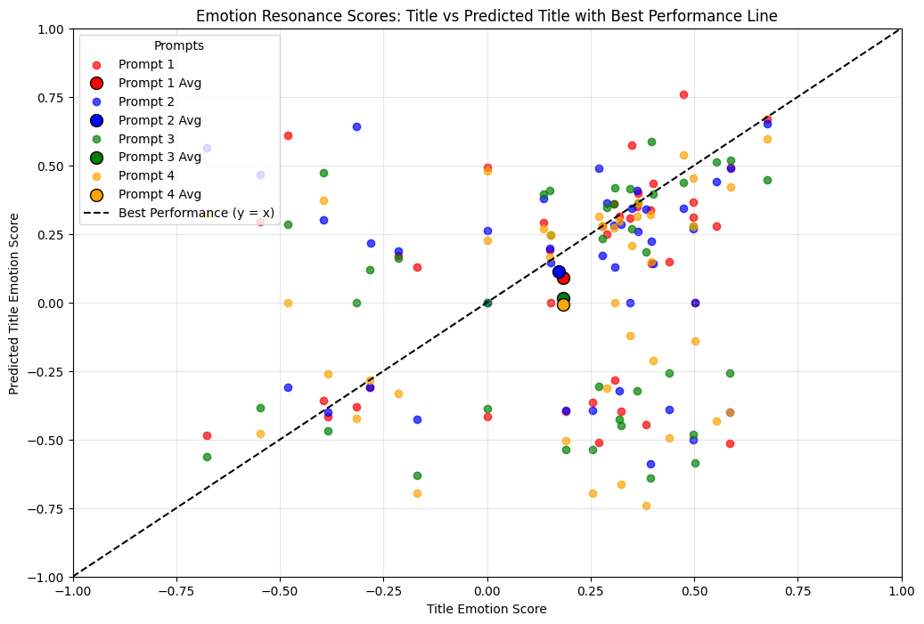
Results: Emotional Resonance
 | Mean Absolute Error (MAE)
Prompt 1 | 0.30
Prompt 2 | 0.35
Prompt 3 | 0.37
Prompt 4 | 0.37
Predicted Title Sentiment
True Title Sentiment
<
True Title Sentiment
Predicted Title Sentiment
<
Notes:
Concluding that AI is not yet effective in successfully expressing emotion

Slide 15
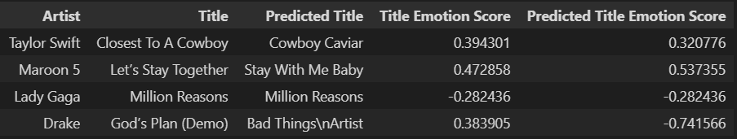
Results: examples

Slide 16
Results
 | Title Average Absolute Emotional Resonance Score | Predicted Title Average Absolute Emotional Resonance Score
Prompt 1 | 0.33 | 0.32
Prompt 2 | 0.35 | 0.33
Prompt 3 | 0.36 | 0.38
Prompt 4 | 0.36 | 0.35

Slide 17
Conclusion
Small (7b parameter) models can achieve reasonable degree of semantic similarity when predicting titles
Phrasing prompts can have significant impact on outcome: Queries that are more descriptive and clear, without much room of freedom, generally produce better outcomes.
Humans remain better at expressing emotion: AI model struggles to express emotions even when explicitly told to do so.
Future work
Apply same approach to larger models (e.g.GPT4o)
Explore adding audio features (intonation, tempo, instrumentation)
Fine-tune model: Training on song data, integrate emotional resonance score
Expand application to movies, books, research papers, advertisements, etc. based on perceived emotional resonance

Slide 18

THANK YOU

